Slide 1
Azure Training Day Migrating .NET applications to Azure

Slide 2

Presentation title
Let’s get Started!
Tell us what you think by completing our survey
Schedule a post-event session to address your specific requirements.
Speaker name
Title
Learn more : aka.ms/techdocs
Get certified : aka.ms/microsoftlearn
Sign up Developer newsletter: aka.ms/usdevconnect

Slide 3


About Me…
Peter De Tender – MCT, Azure MVP
CEO and Lead Technical Trainer of 007FFFLearning.com, +20 years IT experience, mainly datacenters and Microsoft Infrastructure background
Full-time in Azure since 2013 (Readiness & Architect)
Azure Advisor, Azure Certified Architect
Technical Writer, Book author, Courseware Creator
Living in Belgium, but traveling worldwide 90% of my time, helping larger Microsoft Partners, customers and Microsoft FTEs in learning about and using Azure, by providing workshops with passion
peter@pdtit.be
@pdtit @007FFFLearning
http://www.facebook.com/pdtit
http://www.linkedin.com/in/pdtit

Slide 4
Workshop delivery
For the technical trainers:
Each Module could be presented as a stand-alone module, although the full potential comes from delivering all modules
HOL are somehow depending on each other, starting from the IAC-lab, where students deploy the VM-based source environment, moving to WebApps, SQL PaaS, Docker, Azure Container Registry, running Azure Container Instance, and ultimately Azure Container Services with Kubernetes. (only labs that could be skipped are WebApps and AKS)
The HOL solution is based on a ASP.NET Core app « SimplCommerce » (Open Source), using SQL Database

Slide 5
Workshop delivery
For the technical trainers:
Whenever you detect any mistakes, issues, wrong wordings,… in presentations or LAB guides, please send an email to :
msdevseriessupport@007FFFLearning.com, subject « Azure Developer Series – Containers », so we can take care of this and fixing it immediately
Latest version of all content should be available on GitHub:
http://www.github.com/007FFFLearning/MSDevSeriesSupport

Slide 6
Application Migration
Container Orchestration with ACS and AKS
Peter De Tender
@pdtit @007FFFlearning

Slide 7
Introduction to Orchestration

Slide 8
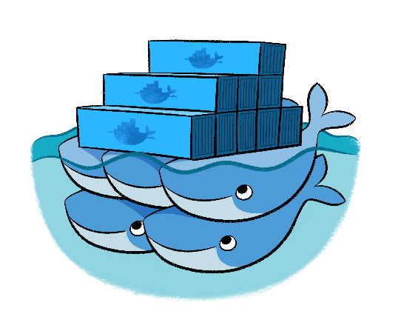
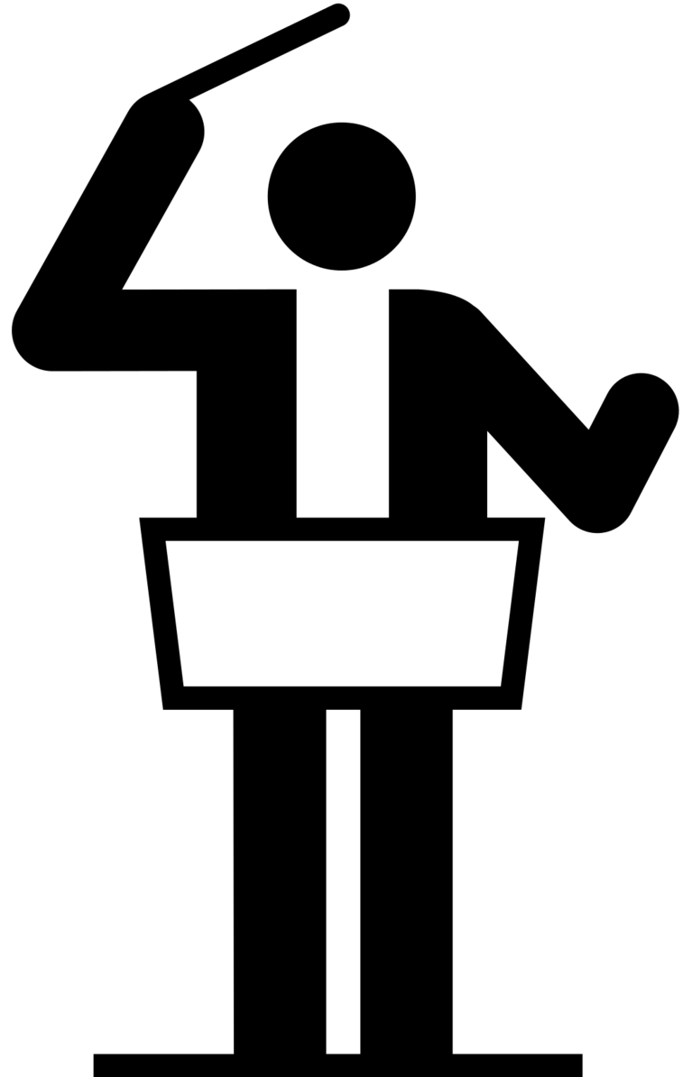
Why Container Orchestration?
Azure Container Instance (ACI) or Azure Webapps for Containers run Containers as « stand-alone » resources
Orchestration gives you:
Auto-Scaling
Rolling Upgrades
Service Discovery
Integrated Load-Balancing
Affinity / anti-affinity
Scaling Options
Custom Resource Sizing
…

Slide 9
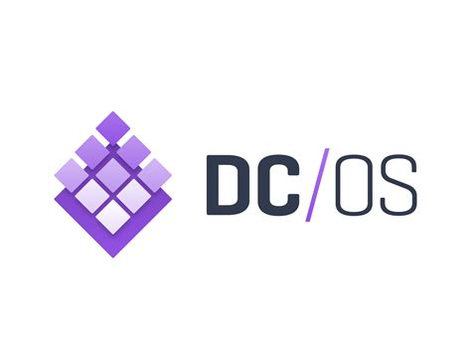
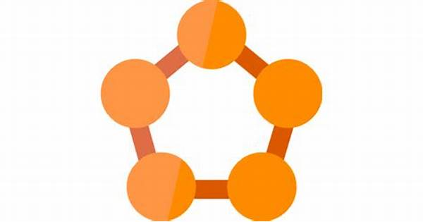
What Container Orchestration Is There?
What solutions are available?
Kubernetes
Service Fabric
Docker Swarm
DC/OS Mesosphere

Slide 10
What Container Orchestration Is There – in Azure?
What Orchestration tools are available in the Azure Platform?
Azure Kubernetes Service (AKS)
Azure Service Fabric
Docker Enterprise
(IAAS)
DC/OS Mesosphere (IAAS)

Slide 11
What makes Kubernetes the “Go-To” orchestrator?
The preferred Azure Container Orchestrator
Portable across clouds
Public, Private, Hybrid, Multi-Cloud
Extensible
Modular, pluggable, composable
Self-Healing
Auto-placement, Auto-Restart, Scaling,…

Slide 12
Base Kubernetes Architecture
Internet
4
Kubernetes control
2
Worker node
Kubernetes users communicate with API server and apply desired state
kubelet
kube-proxy
Master node
Docker
Master nodes actively enforce desired state on worker nodes
3
1
Prod
Prod
API server
Containers
Containers
Worker nodes support communication between containers
-controller-manager
-scheduler
2
Worker node
kubelet
kube-proxy
Worker nodes support communication from the Internet
replication, namespace, serviceaccounts, etc.
etcd
Docker
3
Prod
Prod
Containers
Containers

Slide 13
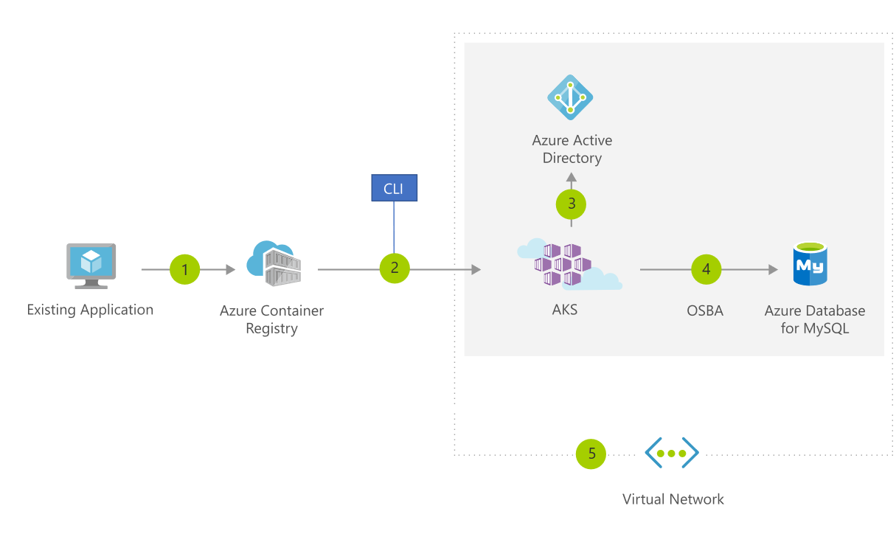
Azure Kubernetes Services (AKS) in-depth
The preferred Azure Container Orchestrator
Easily deploy from Portal or CLI
IAC with ARM or Terraform
Start with a single node and scale out
Deploy apps into AKS using Azure DevOps CI/CD Pipeline
NOW supports both Linux and Windows as Nodes

Slide 14
How managed Kubernetes on Azure works
Automated upgrades, patches
High reliability, availability
Easy, secure cluster scaling
Self-healing
API server monitoring
At no charge (you still pay for the worker nodes)
Azure managed control plane
App/ workload definition
Self-managed master node(s)
Kubernetes API endpoint
etcd Store
User
API server
Scheduler
Controller Manager
Cloud Controller
Schedule pods over private tunnel
Customer VMs
Docker
Docker
Docker
Docker
Docker
Pods
Pods
Pods
Pods
Pods

Slide 15






AKS end-to-end experience inside Azure DevOps
Helm chart
AKS production cluster
Front end
Inner loop
Azure Container Registry
Source code control
Azure Monitor
Azure DevSpaces
AKS dev cluster
Test
Business logic
Debug
Auto-build
Azure Pipelines/ DevOps Project
Database tier
CI/CD
Developer owns this
ACR and Azure DevOps
Azure AKS Control Plane
Azure Monitor

Slide 16
Deploying Azure Kubernetes Services
Using Azure CLI
az aks create --resource-group AKSnativeRG --name AKSCluster --node-count 1 --enable-addons monitoring --generate-ssh-keys
az aks get-credentials –resource-group AKSnativeRG –name AKSCluster

Slide 17
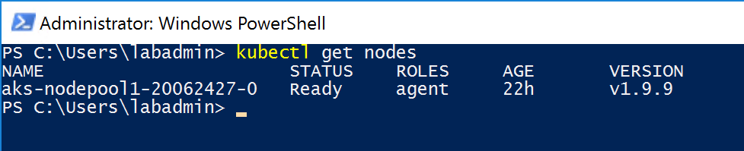
Managing Azure Container Services
KubeCTL Command Line
az aks install-cli
Kubectl get nodes

Slide 18
Demo
Deploying Azure Kubernetes Services using Azure CLI

Slide 19
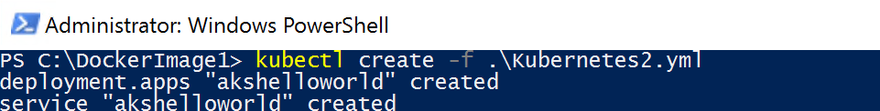
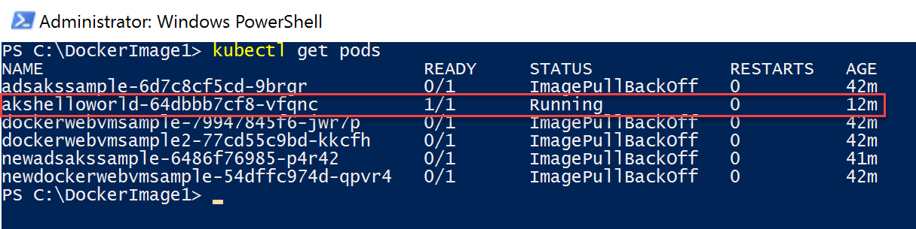
Integrating AKS with ACR
Running a Container Registry Image inside Azure Container Services
Kubectl create –f “path to YAML-file”
app: akshelloworld
spec:
containers:
- name: adsacr
image: docker.io/microsoft/aci-helloworld
ports:
- containerPort: 80
imagePullSecrets:
- name: adsacr-auth

Slide 20
Demo
Running a Docker Hub image in Azure Kubernetes Services

Slide 21


Azure Kubernetes Service Architecture
Managed
Managed Control Plane
Automated upgrades and patching
Easy cluster scaling
Cost Savings
App Developer
Docker
Azure Infrastructure Services (VMs, Networking, Storage,…)
IT Pro - Sysadmin

Slide 22
AKS end-to-end experience inside Azure DevOps
Helm chart
AKS production cluster
Front end
Inner loop
Azure Container Registry
Source code control
Azure Monitor
Azure DevSpaces
AKS dev cluster
Test
Business logic
Debug
Auto-build
Azure Pipelines/ DevOps Project
Database tier
CI/CD
Developer owns this
ACR and Azure DevOps
Azure AKS Control Plane
Azure Monitor

Slide 23
Demo
AKS end-to-end integration with Azure DevOps

Slide 24
Azure Dev Spaces
Azure Dev Spaces helps development teams be more productive on Kubernetes in the following ways:
Minimize local dev machine setup for each team member and work directly in AKS, a managed Kubernetes cluster in Azure.
Rapidly iterate and debug code directly in Kubernetes using Visual Studio 2017 or VS Code.
Generate Docker and Kubernetes configuration-as-code assets for you to use from development through to production.
Share a managed Kubernetes cluster with your team and collaboratively work together. Develop your code in isolation, and do end-to-end testing with other components without replicating or mocking up dependencies.

Slide 25
Deploying Azure Dev Spaces in AKS
Using Azure CLI
az aks use-dev-spaces –resource-group AKSnativeRG –name AKSCluster
=> Your AKS Cluster must already be up and running ☺

Slide 26
Demo
Azure Dev Spaces with AKS

Slide 27
Deploying AKS for Windows

Slide 28
AKS for Windows Nodes
The preferred Azure Container Orchestrator for Windows Containers
Provides AKS Master (Linux)
Provides AKS Nodes (Win2019)
It’s AKS as you know AKS
Deployment is done using AKS-Engine
Management is done using Kubectl (No Azure Portal integration yet)

Slide 29
Demo
AKS-Engine for Windows cluster deployment walkthrough

Slide 30
Section Take-Aways
Azure offers several Container Orchestration Solutions
Kubernetes – and thus Azure Kubernetes Services (AKS) is the « go-to » orchestration service
AKS supports both Linux and Windows (2019) Nodes, allowing to run about any containerized application, no matter the platform characteristics

Slide 31
Questions
Landing
Spot
“…If you want good answers, ask better questions…”
© Randy Glasbergen

Slide 32
Next Module…
Azure DevOps Pipelines
@pdtit @007FFFlearning

Slide 33
Thank You

